Slide 1


Object Oriented Programming with JAVA
Department of Computer Science & Engineering, PIET

Slide 2


UNIT- 9
MULTI THREADING

Slide 3
MULTI TASKING
Multitasking is a process of executing multiple tasks simultaneously.
We use multitasking to utilize the CPU.
Multitasking can be achieved in two ways:
Process-based Multitasking (Multiprocessing)
Thread-based Multitasking (Multithreading)

Slide 4
1) Process-based Multitasking (Multiprocessing)
Each process has an address in memory. In other words, each process allocates a separate memory area.
A process is heavyweight.
Cost of communication between the process is high.
Switching from one process to another requires some time for saving and loading registers, memory maps, updating lists, etc

Slide 5
2) Thread-based Multitasking (Multithreading)
Threads share the same address space.
A thread is lightweight.
Cost of communication between the thread is low.

Slide 6
PROCESS AND THREADS
The Program in execution is defined as Process. Thus, the process based multi tasking is the feature that allows your computer to run two or more programs concurrently. For example we are able to use the java compiler and text editor at the same time. Another example is, we are able to hear the music and also able to get the print outs from the printer.
The Thread is the smallest unit of dispatchable code. This means that the single program can contain two or more parts, each part of the program is called, Thread. For example the text editor can be formatting the text and also printing the text. Although the Java programs make use of the process-based multi tasking environments, but the process-based multi tasking is not under the control of java, Where as the thread-based multitasking is under the control of Java.

Slide 7
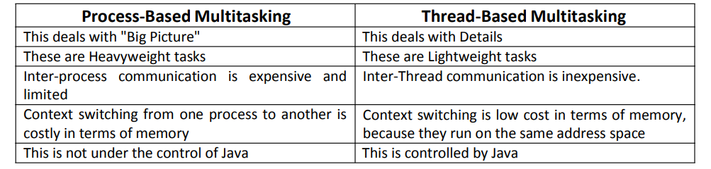
Difference between Process and Threads

Slide 8
ADVANTAGES OF MULTITHREADING
It enables you to write very efficient programs that maximizes the CPU utilization and reduces the idle time.
Most I/O devices such as network ports, disk drives or the keyboard are much slower than CPU.
A program will spend much of it time just send and receive the information to or from the devices, which in turn wastes the CPU valuable time.
By using the multithreading, your program can perform another task during this idle time.
For example, while one part of the program is sending a file over the internet, another part can read the input from the keyboard, while other part can buffer the next block to send.
It is possible to run two or more threads in multiprocessor or multi core systems simultaneously.

Slide 9
THREAD LIFE CYCLE
During the life time of the thread, there are many states it can enter. They include the following:
Newborn state
Runnable State
Running State
Blocked state
Dead state

Slide 10
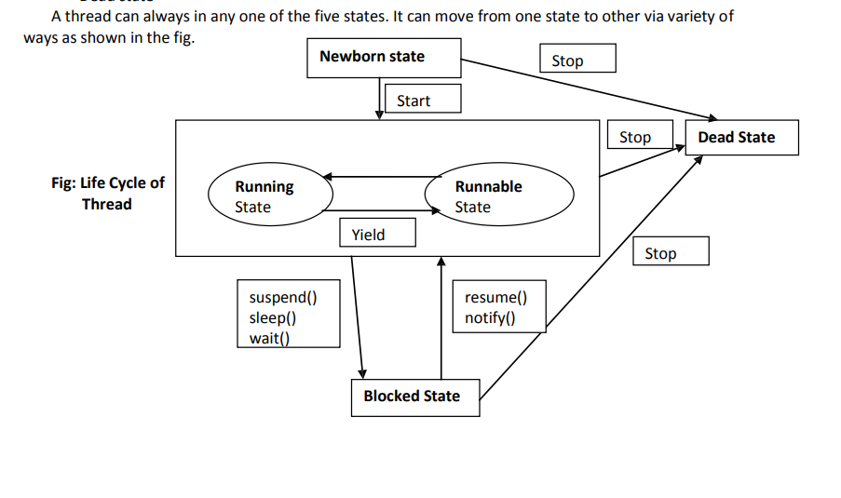
Diagram of Thread Life Cycle

Slide 11
NEWBORN,RUNNABLE STATES
Newborn State: When we create a thread it is said to be in the new born state. At this state we can do the following:
schedule it for running using the start() method.
Kill it using stop() method.
Runnable State: A runnable state means that a thread is ready for execution and waiting for the availability of the processor. That is the thread has joined the queue of the threads for execution. If all the threads have equal priority, then they are given time slots for execution in the round robin fashion, first-come, first-serve manner. The thread that relinquishes the control will join the queue at the end and again waits for its turn. This is known as time slicing.

Slide 12
RUNNING, BLOCKED, DEAD STATES
Running state: Running state means that the processor has given its time to the thread for it execution. The thread runs until it relinquishes the control or it is preempted by the other higher priority thread. As shown in the fig. a running thread can be preempted using the suspend(), wait(), sleep() methods.
Blocked state: A thread is said to be in the blocked state when it is prevented from entering into runnable state and subsequently the running state.
Dead state: Every thread has a life cycle. A running thread ends its life when it has completed execution. It is a natural death. However we also can kill the thread by sending the stop() message to it at any time.

Slide 13
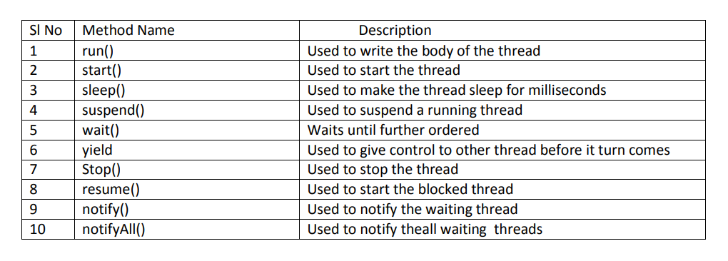
THE THREAD METHODS

Slide 14
TYPES OF THREADS
Java offers two types of threads: user threads and daemon threads.
User threads are high-priority threads. The JVM will wait for any user thread to complete its task before terminating it.
Daemon threads are low-priority threads whose only role is to provide services to user threads.
Since daemon threads are meant to serve user threads and are only needed while user threads are running, they won’t prevent the JVM from exiting once all user threads have finished their execution.

Slide 15
CREATING AND RUNNING A THREAD
There are two ways to create a thread:
By extending Thread class.
By implementing Runnable interface.
Thread class:
Thread class provide constructors and methods to create and perform operations on a thread. Thread class extends Object class and implements Runnable interface.

Slide 16
Run() and start() Methods
Runnable interface:
The Runnable interface should be implemented by any class whose instances are intended to be executed by a thread. Runnable interface have only one method named run().
public void run(): is used to perform action for a thread.
Starting a thread:
The start() method of Thread class is used to start a newly created thread. It performs the following tasks:
A new thread starts(with new callstack).
The thread moves from New state to the Runnable state.
When the thread gets a chance to execute, its target run() method will run.

Slide 17
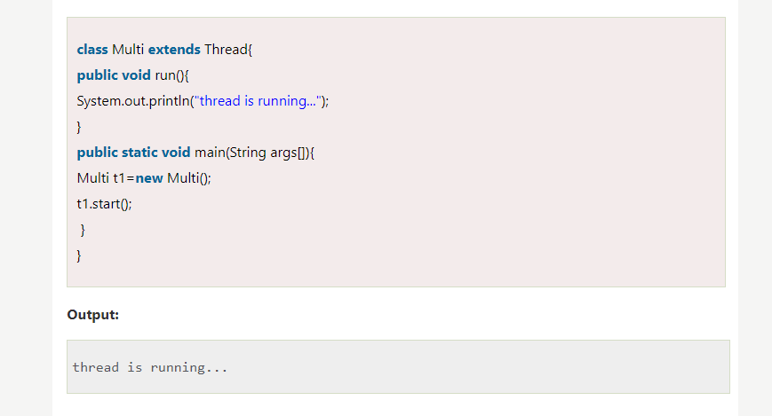
1) Java Thread Example by extending Thread class men

Slide 18
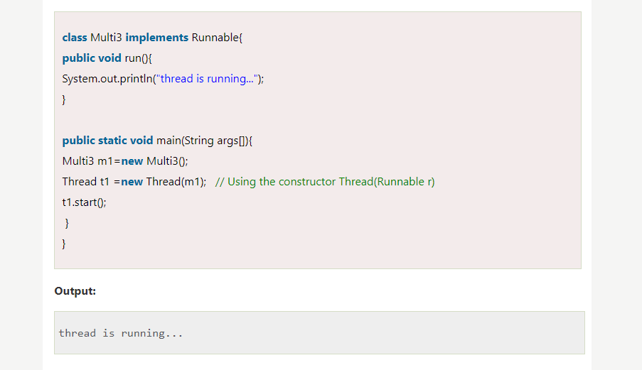
2) Java Thread Example by implementing Runnable interface

Slide 19
Suspending, Blocking and Stopping Threads
Whenever we want stop a thread we can stop from running using "stop()" method of thread class. It's general form will be as follows:
Thread.stop(); This method causes a thread to move from running to dead state. A thread will also move to dead state automatically when it reaches the end of its method.
Blocking Thread - A thread can be temporarily suspended or blocked from entering into the runnable and running state by using the following methods:
sleep() —blocked for specified time.
suspend() ----blocked until further orders.
wait() --blocked until certain condition occurs.
These methods cause the thread to go into the blocked state. The thread will return to the runnable state when the specified time is elapsed in the case of sleep(), the resume() method is invoked in the case of suspend(), and the notify() method is called in the case of wait().

Slide 20
Example Program:
The following program demonstrates these methods: // Using suspend() and resume().
class NewThread implements Runnable
{
String name; // name of thread
Thread t;
NewThread(String threadname) {
name = threadname;
t = new Thread(this, name); System.out.println("New thread: " + t);
t.start(); // Start the thread
}
// This is the entry point for thread.
public void run() {
try
{
for(int i = 15; i > 0; i--)
{
System.out.println(name + ": " + i); Thread.sleep(200);
} }
catch (InterruptedException e)
{
System.out.println(name + " interrupted.");
}
System.out.println(name + " exiting."); }
}

Slide 21
class SuspendResume
{
public static void main(String args[])
{
NewThread ob1 = new NewThread("One"); NewThread ob2 = new NewThread("Two");
try
{
Thread.sleep(1000); ob1.t.suspend(); System.out.println("Suspending thread One"); Thread.sleep(1000); ob1.t.resume(); System.out.println("Resuming thread One"); ob2.t.suspend(); System.out.println("Suspending thread Two"); Thread.sleep(1000);
ob2.t.resume();
System.out.println("Resuming thread Two");
}
catch (InterruptedException e)
{
System.out.println("Main thread Interrupted"); } // wait for threads to finish
try {
System.out.println("Waiting for threads to finish.");
ob1.t.join();
ob2.t.join(); }
catch (InterruptedException e) { System.out.println("Main thread Interrupted"); } System.out.println("Main thread exiting."); } }

Slide 22

www.paruluniversity.ac.in

